Slide 1
Test Reporting and Guidelines

Slide 2
Test report is an assessment of how well the Testing is performed. Based on the test report, stakeholders can evaluate the quality of the tested product and make a decision on the software release.

Slide 3
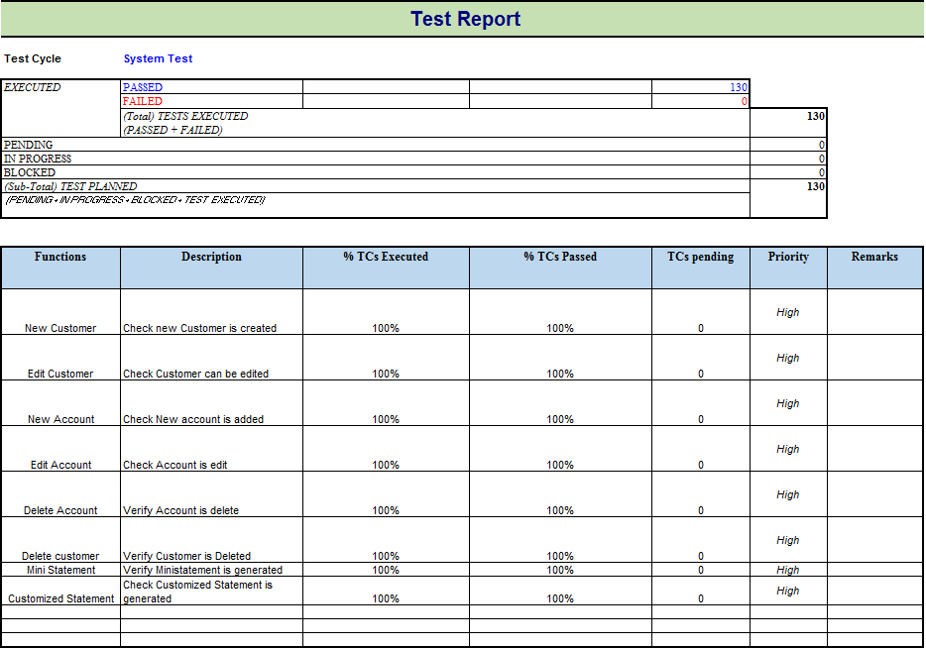

Slide 4
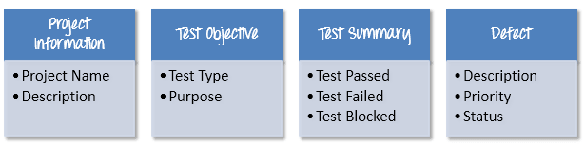
Test Report

Slide 5
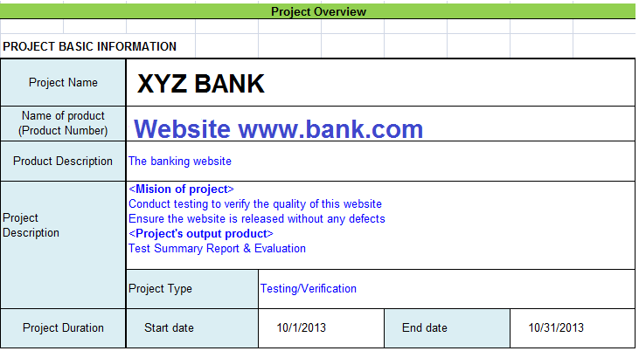

Slide 6
Test Summary
This section includes the summary of testing activity in general. Information detailed here includes
The number of test cases executed
The numbers of test cases pass
The numbers of test cases fail
Pass percentage
Fail percentage
Comments

Slide 7
Defect Information
One of the most important information in Test Report is defect. The report should contain following information
Total number of bugs
Status of bugs (open, closed, responding)
Number of bugs open, resolved, closed
Breakdown by severity and priority

Slide 8
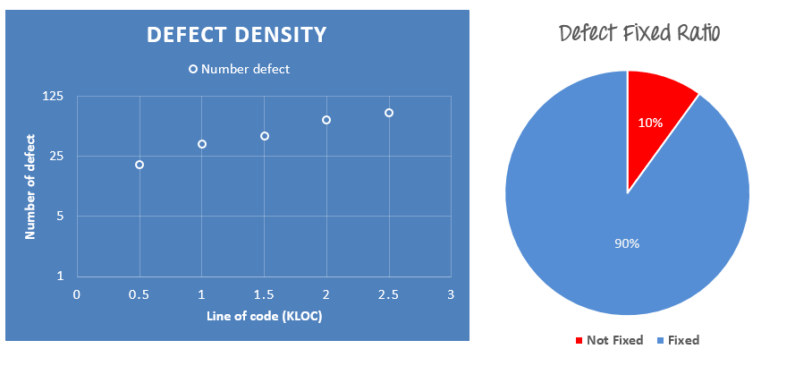
Defect Information

Slide 9
A Good Test Report
Test report is a communication tool between the Test Manager and the stakeholder. Through the test report, the stakeholder can understand the project situation, the quality of product and other things.

Slide 10
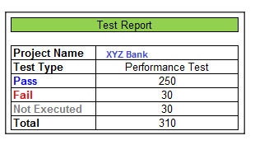
A Good Test Report
You co-operate with outsourcing company, its tester after having performed Performance Testing of the website XYZ Bank, sends you a test report like this

Slide 11
A Good Test Report
The information of that report is too abstract. It does not have any detailed information. The stakeholder who will read it might be slightly puzzled when they get it. They might ask or have following sets of questions: -
Why did they not execute 30 TCs that remains
What are these failed Test Cases
Doesn't have any bugs description

Slide 12
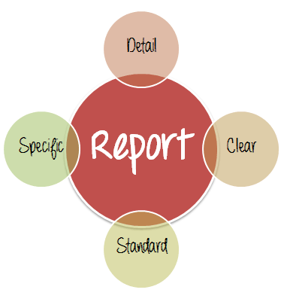
A Good Test Report
To solve that problem, a good Test Report should be:

Slide 13
A Good Test Report
Detail: You should provide a detailed description of the testing activity, show which testing you have performed. Do not put the abstract information into the report, because the reader will not understand what you said.
Clear: All information in the test report should be short and clearly understandable.

Slide 14
A Good Test Report
Standard: The Test Report should follow the standard template. It is easy for stakeholder to review and ensure the consistency between test reports in many projects.
Specific: Do not write an essay about the project activity. Describe and summarize the test result specification and focus on the main point.

Slide 15
A Good Test Report
For example, to correct the above Test Report, the tester should provide more information such as:
Project information
Test cycle: (System Test, Integration Test...etc.)
Which functions have already tested (% TCs executed, % TCs passed or fail…)
Defect report (Defect description, Priority or status...)

Slide 16
Testing Scope
In Scope--- What all we have tested in this release of modules
Out of Scope– What was not part of the modules and we have not tested these modules
Items not to be tested : Some of the functionalities in this release are yet to be tested which are 1, 2,3….

Slide 17
12 Steps Guide To Writing An Effective Test Summary Report
Step #1) Purpose of the document
<Short description of the objective of preparing the document>
For Example, This document explains the various activities performed as part of the Testing of the ‘ABCD Transport System’ application.

Slide 18
12 Steps Guide To Writing An Effective Test Summary Report
Step #2) Application Overview
<Brief description of the application tested>
For Example, ‘ABCD Transport System’ is a web-based Bus ticket booking application. Tickets for various buses can be booked using the online facilities. Real-time passenger information is received from a ‘Central Repository System’, which will be referred before booking is confirmed. There are several modules like Registration, Booking, Payment, and Reports which are integrated to fulfill the purpose.

Slide 19
12 Steps Guide To Writing An Effective Test Summary Report
Step #3) Testing Scope
In Scope
Out of Scope
Items not tested
<This section explains the functions/modules in scope & out of scope for testing; Any items which are not tested due to any constraints/dependencies/restrictions>

Slide 20
12 Steps Guide To Writing An Effective Test Summary Report
Step #4) Metrics
No. of test cases planned vs executed
No. of test cases passed/failed

Slide 21
12 Steps Guide To Writing An Effective Test Summary Report
Step #5) Types of testing performed
Smoke Testing
System Integration Testing
and Regression Testing

Slide 22

12 Steps Guide To Writing An Effective Test Summary Report
Step #6) Test Environment & Tools
<Provide details on Test Environment in which the Testing is carried out. Server, Database, Application URL, etc. If any Tools were used like >

Slide 23
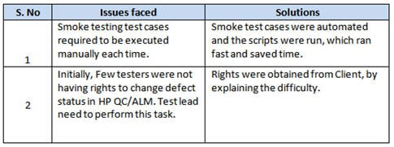
12 Steps Guide To Writing An Effective Test Summary Report
Step #7) Lessons Learned
<This section is used to describe the critical issues faced and their solutions (how they were solved during the Testing). Lessons learned will help to make proactive decisions during the next Testing engagement, by avoiding these mistakes or finding a suitable workaround>

Slide 24
12 Steps Guide To Writing An Effective Test Summary Report
Step #8) Recommendations
<Any workaround or suggestions can be mentioned here>
Step #9) Best Practices
<There will be a lot of activities done by the Testing team during the project. Some of them could have saved time, some proved to be a good & efficient way to work, etc. These can be documented as a ‘Value Add’ to showcase to the Stakeholders>
Step #10) Exit Criteria
<Exit Criteria is defined as a Completion of Testing by fulfilling certain conditions like
(i) All planned test cases are executed;
(iI) All Critical defects are Closed etc.>

Slide 25
12 Steps Guide To Writing An Effective Test Summary Report
Step #11) Conclusion/Sign Off
<This section will mention whether the Testing team agrees and gives a Green signal for the application to ‘Go Live’ or not after the Exit Criteria was met. If the application does not meet the Exit Criteria, then it can be mentioned as – “The application is not suggested to ‘Go Live’. It will be left with the decision of Senior Management and Client and other Stakeholders involved to take the call on whether the application can ‘Go Live’ or not.>
Step #11) Conclusion/Sign Off
<This section will mention whether the Testing team agrees and gives a Green signal for the application to ‘Go Live’ or not after the Exit Criteria was met. If the application does not meet the Exit Criteria, then it can be mentioned as – “The application is not suggested to ‘Go Live’. It will be left with the decision of Senior Management and Client and other Stakeholders involved to take the call on whether the application can ‘Go Live’ or not.>

Slide 26
12. Definitions , Acronyms, and Abbreviations
<This section mentions the meanings of Abbreviated terms used in the document and any other new definitions>

